Slide 1
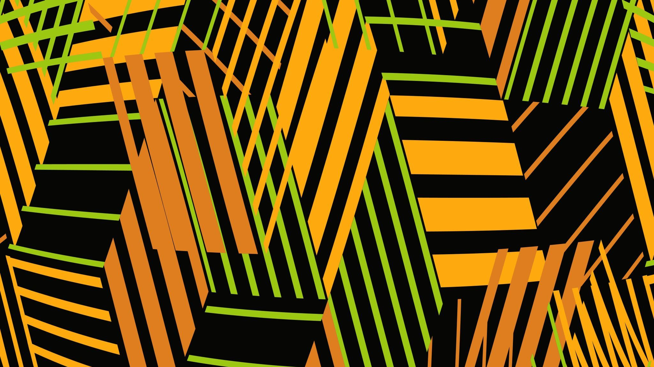
Plant disease detector
Evan Bradshaw, Wyatt Bridges, Isabel Ehrlich, Jeshlymar Vicente Maldonado, Yosel Rivera

Slide 2
Problem Recap
Problem: Diseases in crops and trees often go undetected or misdiagnosed which leads to widespread damage and economic loss. Early detection is crucial for protecting food supply and agricultural stability.
Approach: We developed a machine learning classification model which does the following
Identifies trees species.
detects whether a tree is diseased
determines the specific disease if detected.
We began by focusing on a single tree species until an acceptable accuracy is achieved, in the future the program could be expanded upon by adding other trees.

Slide 3
Data description
Data source(s): The dataset used is the coconut Tree Disease Dataset, obtained from Kaggle. The datasets consists of labeled images organized into five disease categories. Bud Root Dropping, Bud Rot, Gray Leaf Spot, Lead Rot, Stem Bleeding.
Key features (variables): There are Four Key features
Color Variations (green, yellow, brown, gray and signs of discoloration)
Texture Difference (spots)
Shape/structure changes (drooping and deformation)
Pattern recognition (leaf spots, stem streaks)
Data size and structure: The dataset consists five diseases classes, with hundreds of images per class, which is organized into labeled folders. The data is split between 80% training and 20% testing.

Slide 4
Data description
Preprocessing performed:
Resized image to 224 x 224
Random Horizontal Flip
Random Rotation
Converting images to tensors
Normalized pixel values
Split data into validation and training sets

Slide 5
Methodology Continued
Type of model used (classification, regression, clustering): The model used in this project is a classification model.
Algorithms applied: Several algorithms were applied
ResNet-18 (CNN): used for image classification
Adam Optimizer: updated model weights during training
Cross-Entropy Loss: measures prediction error for multi-class classification
Data Preprocessing and Augmentation: resizing, normalization, flipping, and rotation
Train Validation split: separate the data for training and validation
Backpropagation: computes gradients and improves model performance

Slide 6
Methodology
We chose this approach because CNNs are designed to work with images and can extract important visual features. ResNet-18 was chosen because it provides good performance while being efficient, it is not too large which allows it to be trained without taking too long. Preprocessing was used to help prevent overfitting and increase accuracy.

Slide 7
Implementation
Tools/libraries used:
Python: primary programming language for the project
Pytorch: used for building neural networks, defining loss functions, and optimizing models.
torchVision: helps load and preprocess image data, apply transformations, and use pretrained models for training and evaluation
numPy: for numerical operations and array manipulation
tqdm: provides progress bar during training loops.
Os: for interacting with the file system
Random: used to control random behavior.

Slide 8
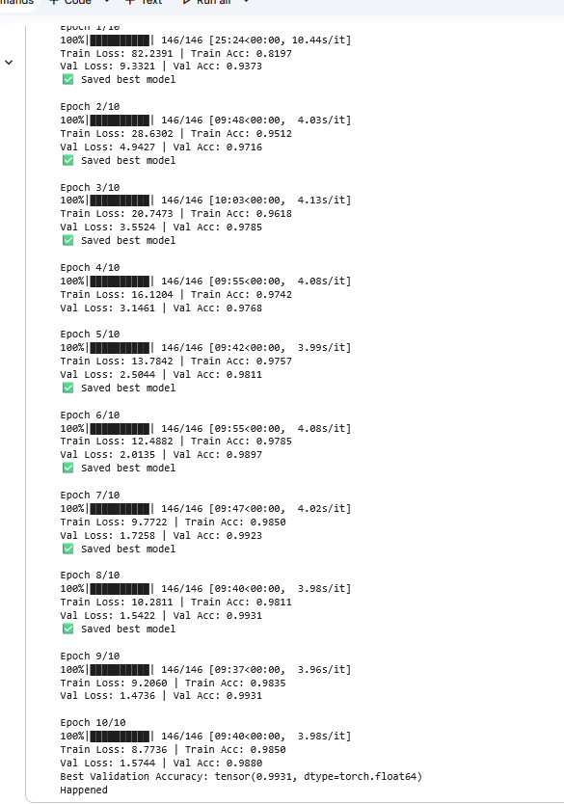
Results
Key findings:
improvements begin to plateau at Epoch 7.
Rapid learning: The model quickly reaches 97% validation accuracy by epoch three which means the model quickly identifies the key visual patterns in the dataset.
Dataset simplicity: the model learns quickly on the dataset which suggests the dataset may be too simple.
No major overfitting signs: the validation accuracy rises alongside the training accuracy.

Slide 9
Discussion
What worked well?
The model was able to quickly improve within the first few epochs
The Use of Resnet-18 worked well for image classification, it handled the data well.
Saving the best model ensured that highest performing version was kept during training.
The Training and Validation accuracy were close showing there was no heavy overfitting.
Real-world impact of your solution: The model could help farmers detect coconut tree diseases early using images. This could protect crops by preventing the spread of disease.

Slide 10
Discussion continued
Challenges or limitations:
The dataset is imbalanced; some classes have more images than others which could make the model biased.
Limited Experience: some members had limited experience with machine learning projects.
The group had limited time to fix all issues thoroughly.
Possible improvements:
Implement early stopping to stop training once improvement stops.
Increase dataset quality by adding more diverse images
Test model on new real-world images to check how well it performs in a real setting.
Perform more hyperparameter tuning
Fix the class imbalance by using weighted loss or oversampling smaller classes.

